Slide 1

Drink and Be Happy
January 23, 2019

Slide 2
Initial Questions
Why do we care?
What countries are happiest? And are they located in specific geographic region?
What countries consume the least/most amount of alcohol?
Which countries suffer from greatest amount of income inequality?
How do these three pieces of data correlate? Is income inequality an indicator of happiness? Or is alcohol consumption?

Slide 3



A Deep Data Dive
Where’s the information?
Data Collection
3
main sources of merged data
Google APIs – geocode latitudes and longitudes
UN World Happiness Rankings
World Bank – Total Alcohol consumption per capita
156
countries around the world
averaged datasets from
2010-2016

Slide 4
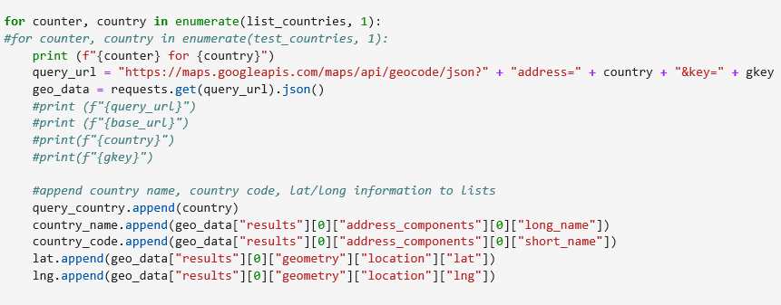
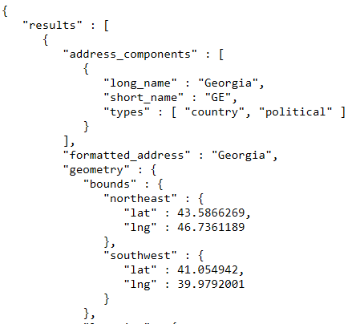
A Deep Data Dive
Where’s the information?
Data Exploration
Google APIs – geocode

Slide 5
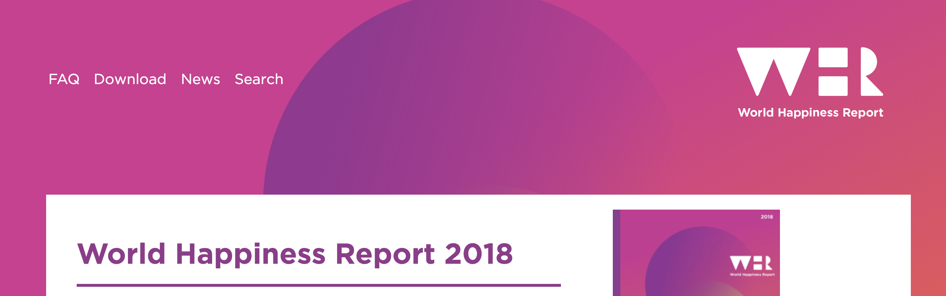
The key variables that have been found to support well-being:
Income
Healthy Life Expectancy
Social Support
Freedom
Trust
Generosity
Gallup World Poll: Cantril ladder: it asks respondents to rate their life, best possible for them being a 10, and the worst possible life being a 0. The typical annual sample is 1,000 people to reduce random sampling errors. The confidence interval is measured at 95% accuracy.

Slide 6
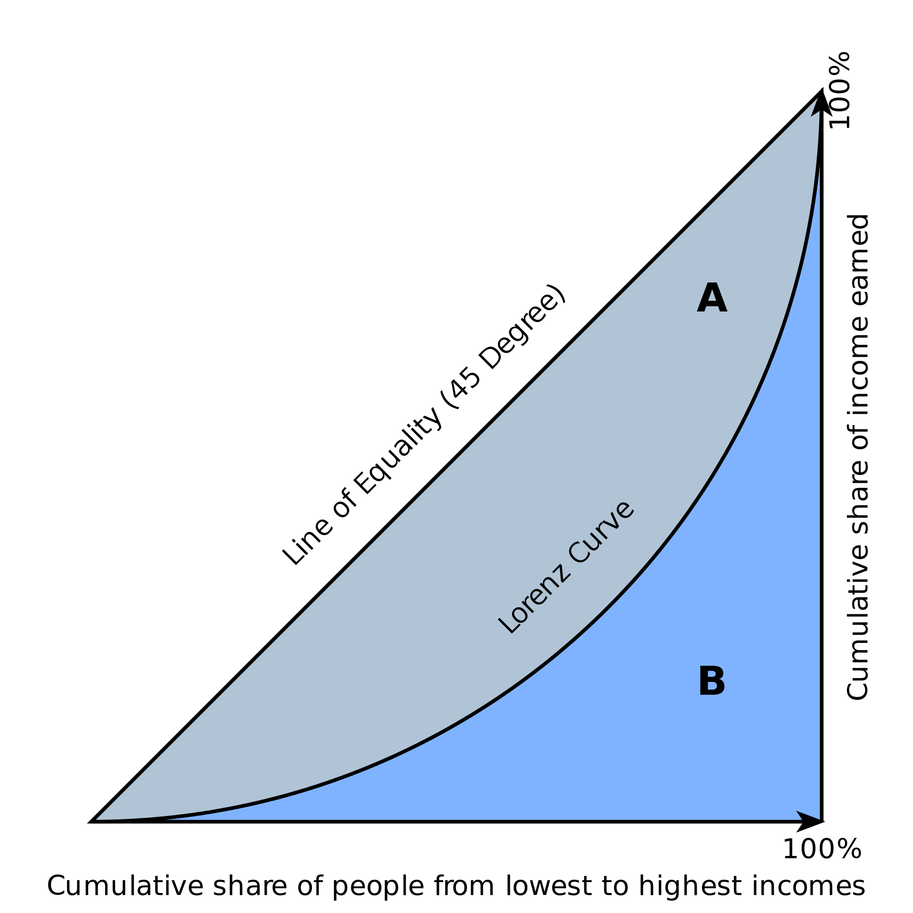
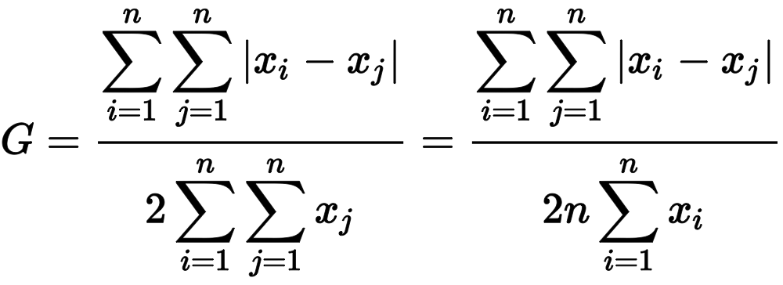
Data Exploration: Happiness Factors
UN World Happiness Rankings
The Gini Coefficient
A single number aimed at measuring the degree of inequality in a distribution. It is most often used in economics to measure how far a country's wealth or income distribution deviates from a totally equal distribution
relative mean absolute difference
which is mathematically equivalent to the Lorenz curve definition

Slide 7
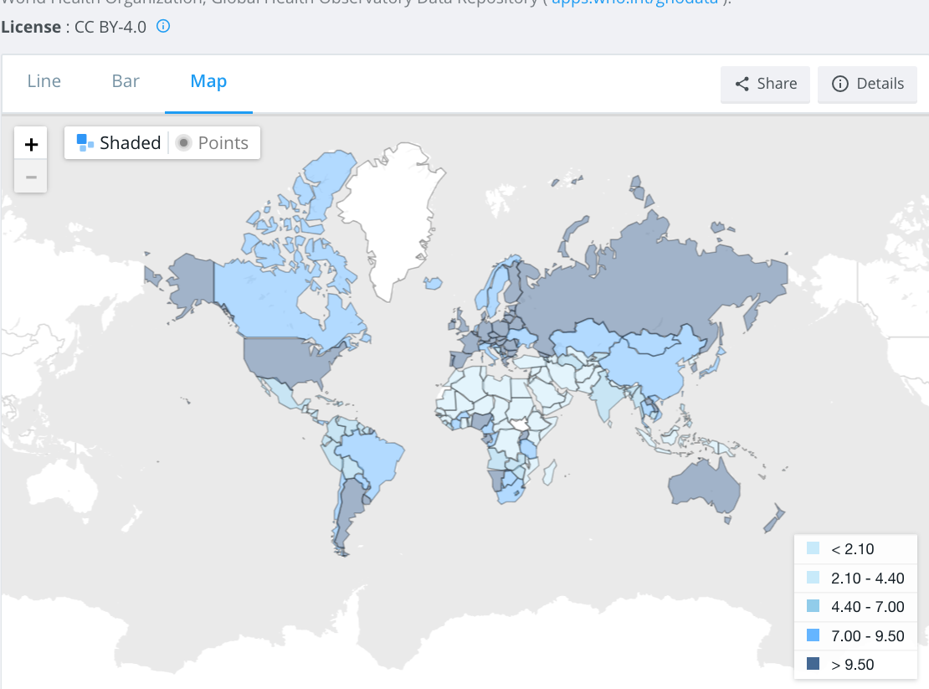
total alcohol consumption per capita
(liters of pure alcohol, projected estimates, 15+ years of age)

Slide 8


A Deep Data Dive
Where’s the information?
Data Cleanup Process
Create country master list
Determine master source of country codes and names
VLOOKUPs, comparisons between .csvs
Resolve Google API country code misalignment

Slide 9
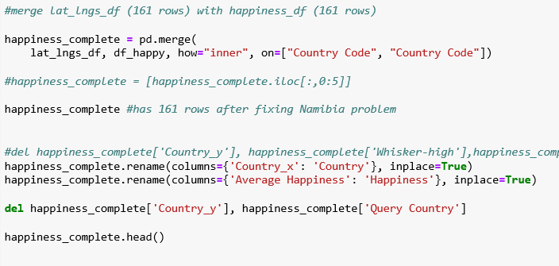

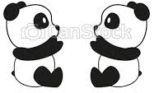
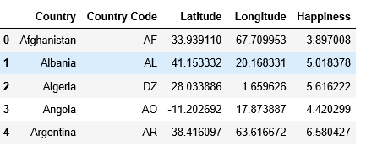
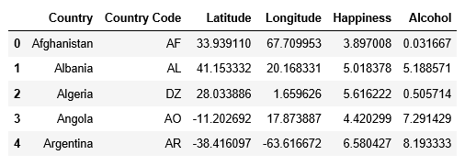
A Deep Data Dive
Where’s the information?
Data Cleanup & Analysis Process
Create Pandas DataFrames for:
Alcohol data
Happiness data
Lat/Long data
Merge Pandas DataFrames

Slide 10
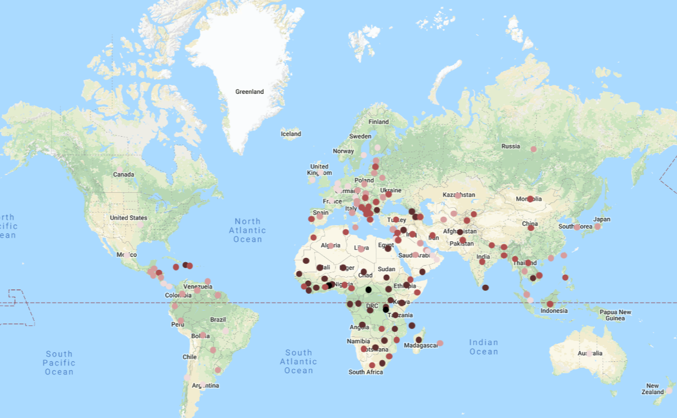
Conclusions
Happiness: most / least
What are the most/least happy countries in the world?
The happiest countries appear to be located primarily in Scandinavia (3) and (7) Europe. The least happy countries are primarily found in Africa, with 9 of the bottom 10.
Happiness Rating of:
7.0
6.0
5.0
4.0
3.0

Slide 11
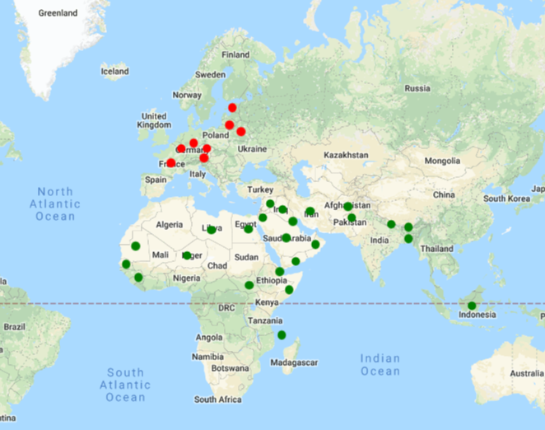
Conclusions
Alcohol Consumption: most / least
Which countries have the most alcohol consumption? Least?
Least alcohol consumption title belongs to Somalia, but it is closely followed by a slew of Middle Eastern and North African countries that are in the surrounding geographical area
Most alcohol consumption title belongs to Estonia, with European countries rounding out the top 20 alcohol consumers, all above 10 liters per year consumption.
most alcohol
12+ liters
least alcohol
>1 liter

Slide 12
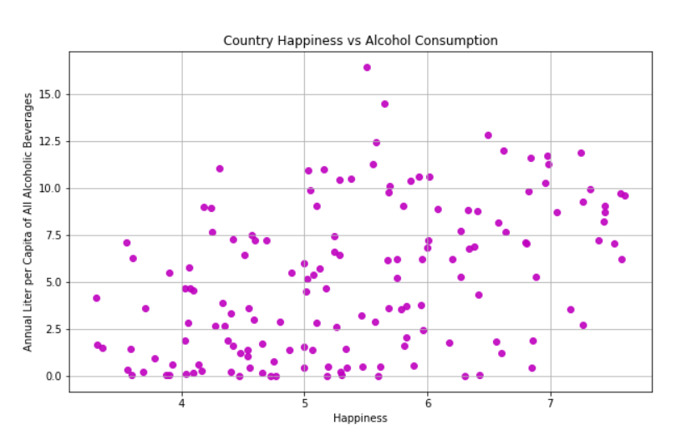
Conclusions
What else did we find? Maybe a need for further digging…
Is there a correlation between alcohol consumption and happiness?
The data doesn’t suggest that there is a correlation between alcohol consumption and happiness. The data appears to be randomly distributed.

Slide 13
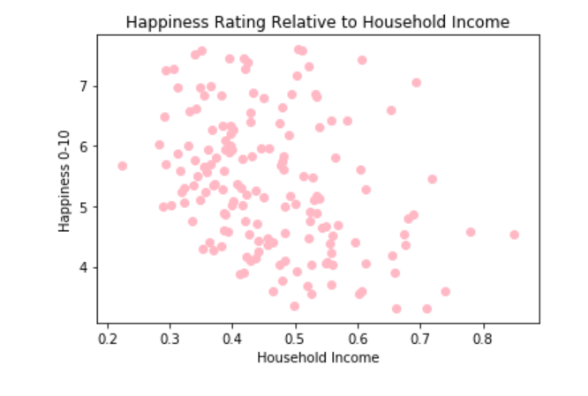
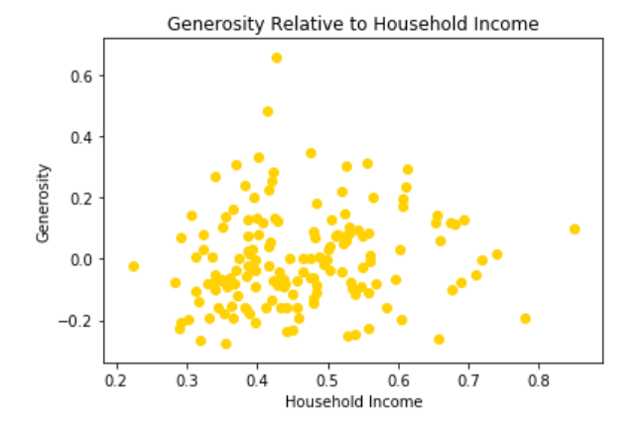
Conclusions: Happiness Factors
How do the different happiness factors correlate?
Analyzing household income

Slide 14
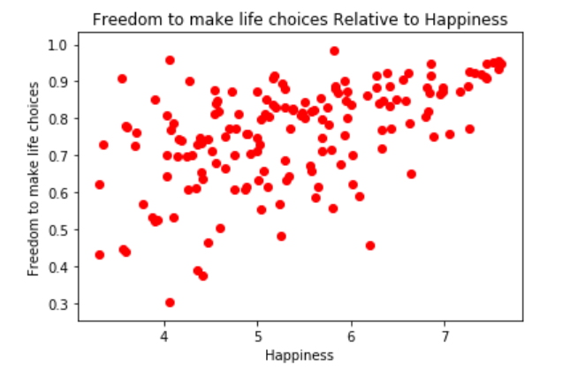
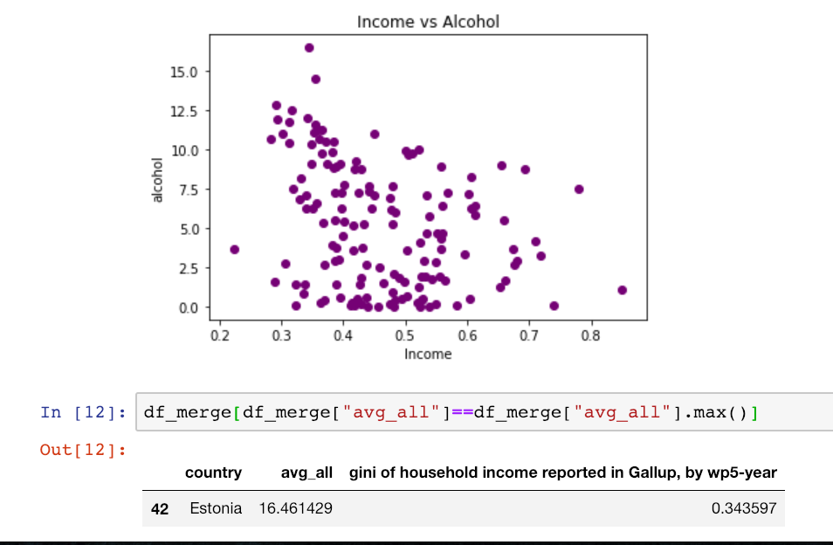
Conclusions: Happiness Factors

Slide 15
Conclusions: Income Inequality
Which countries have the most income inequality?
South Africa has highest instance of GINI coefficient, but South America appears to have the highest concentration of income inequality, with countries such as Honduras, Brazil, Colombia, Paraguay, and making the top 10.
Countries with increased income equality were primarily located in Europe, with 4 of the 10 lowest GINI coefficient countries also being 4 of the 10 happiest nations.
Is there a correlation between income inequality and happiness?
The data shows a seemingly significant trend indicating that reduced income inequality correlates with increased happiness.
Is there a correlation between alcohol consumption and income inequality?
There appears to be a trend where reduced income inequality leads to higher alcohol consumption.

Slide 16
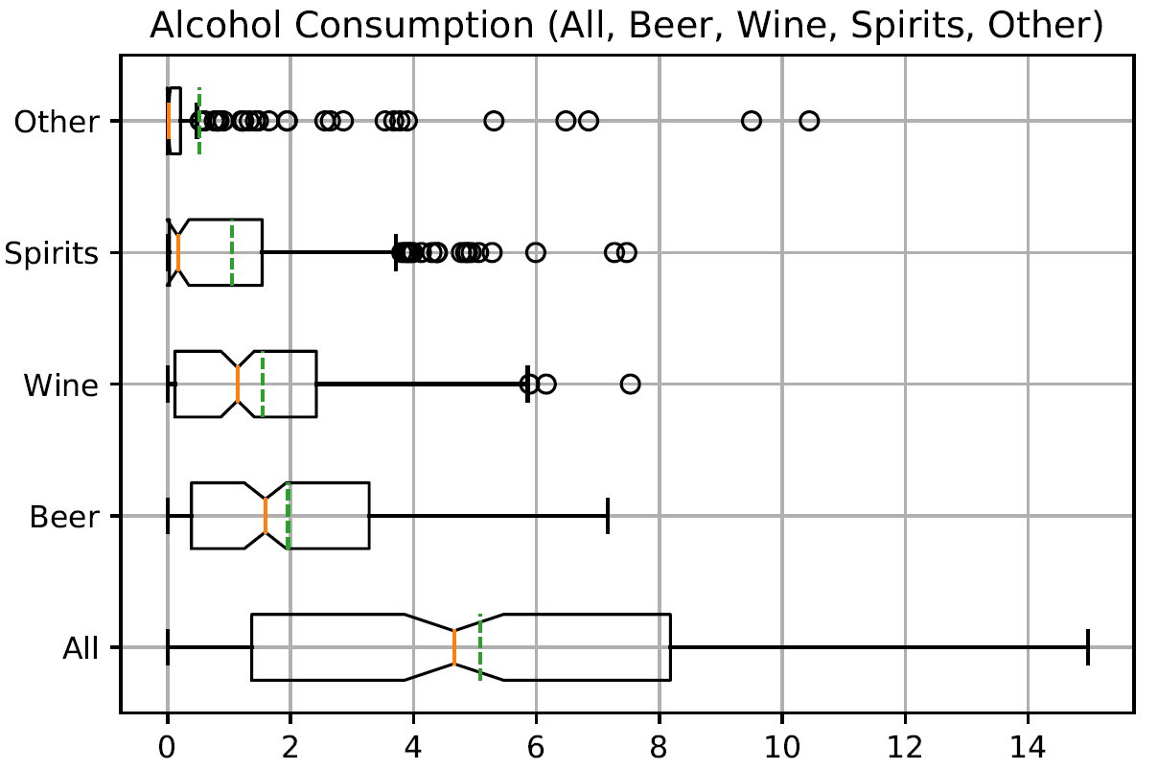
Conclusions: Whiskers for thought

Slide 17
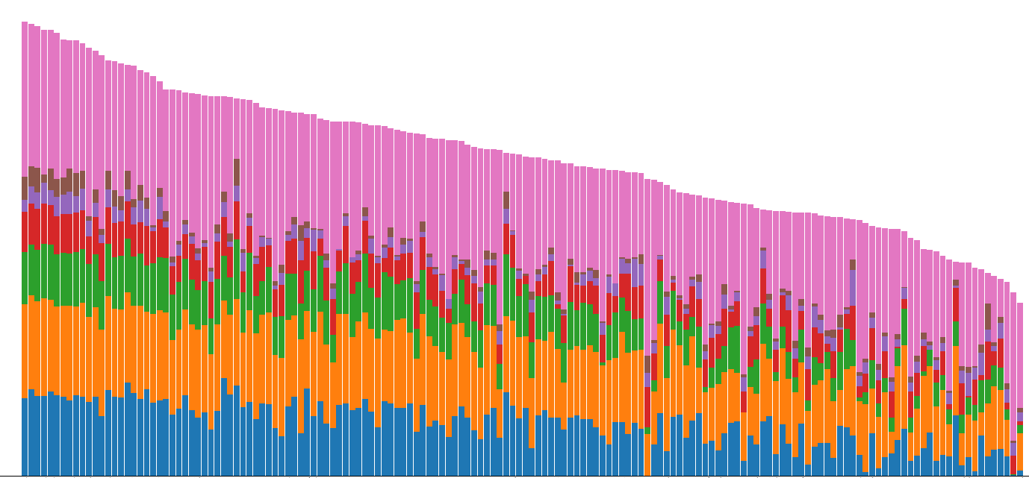
Questions?
We have your answers.

